Slide 1
The Corda platform
LUIZ JERONYMO
JULY 2018

Slide 2
Introduction to R3
01
Notes:
This section aims to cover R3’s story and evolution of our ecosystem

Slide 3
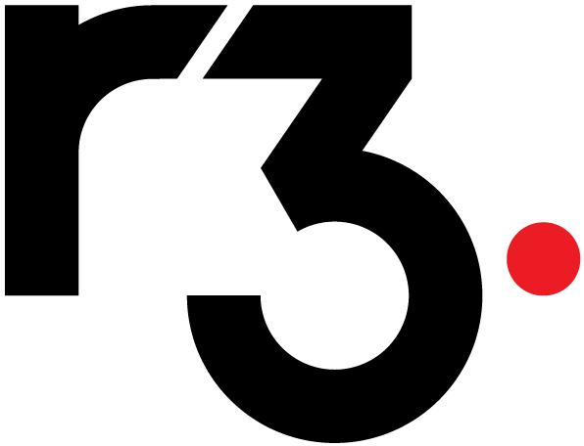
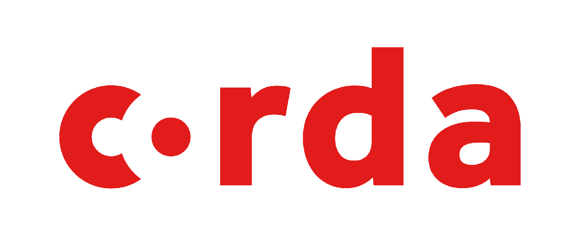
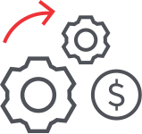
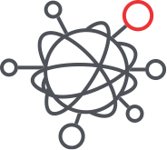
R3 CORDA - ENTERPRISE GRADE BLOCKCHAIN
A GLOBAL NETWORK OF 200+ PARTNERS
With a deep understanding of how finance and business work— R3 was born out of a shared belief that blockchain technology can unlock hidden potential and fundamentally change the way the world does business.
Notes:
R3 is an enterprise software firm working with a network of over hundreds of banks, financial institutions, regulators, trade associations, professional services firms and technology companies to develop on Corda, our blockchain platform designed specifically for businesses.

Slide 4




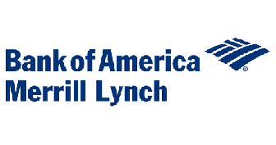



Stage 1:
Our members led us to research the role of blockchain in financial services
Developing an acute understanding
First PoC
FX Settlement
THE INCEPTION OF R3
9
Sept 2014
42
Early 2016
Notes:
R3 was founded through a realization that blockchain could be transformative for the operational challenges within Financial Services
First R3 roundtable was attended by nine banks in Sept 2014 to understand the appetite within Financial Services
First proof of concept delivered for FX settlement on blockchain
R3 became the formal advisor to 42 bank members in early 2016
R3 launched the Architecture Working Group, Product/Use Case Working Group, and Regulatory Working Group to drive understanding

Slide 5



Stage 2:
The creation of Corda
Enterprise grade blockchain from the ground up
Experiments
Payments
Digital Fiat
KYC
Reference Data
Syndicated Loans
Trade Finance
Derivatives
ADDRESSING THE NEEDS OF FINANCIAL SERVICES AND BEYOND
+50
2017
Corda is uniquely architected for PRIVACY, INTEROPERABILITY and IMMUTABILITY
Notes:
An audit of blockchains proved nothing could stand up to the complexity, regulatory demands and rigor needed for financial services
Corda was made public in April 2016, and open-source in November 2016
Additionally over 50 members joined the original 42 bank members
R3 research team completes experiments in areas including payments, and digital fiat currencies KYC, reference data, syndicated loans, Trade Finance (Open Account and Doc Trade) and derivatives
Corda Version 1 shipped October 2017 promising API stability
Corda Version 2 shipped November 2017
Corda Version 3 shipped March 2018 promising additional wire stability
R3 Corda Enterprise will go live in 2018

Slide 6





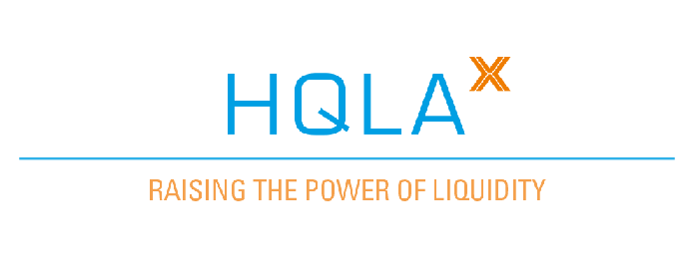

Stage 3:
Corda goes live
Driving change with deployment
Deployment
>50 CorDapps
FROM CONCEPT TO REALITY
>80
PARTNERS
Notes:
Corda 1.0, Corda 2.0, Corda 3.0 and R3 Corda developed for our first Enterprise deployment, including 50+ CorDapps that are currently in development
The world’s first Corda production pilots have occurred, with Calypso/BBVA, Cognizant/Mizuho Blue Ocean, Commerzbank ECP / CS / ING, HQLAx/ING/Credit Suisse
Over 80 partners, including technology companies, systems integrators, consulting firms, and software developers.
Launching Corda Connect, a global network of Corda nodes sharing standards, frameworks and governance

Slide 7
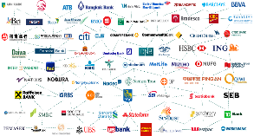
1. Membership (2016)
R3 PORTFOLIO
1
Customers | Members | Stakeholders
Regulators | Central Banks | Legal
R3 started with 42 banks experimenting with blockchain technology in January 2016.
Many of the experiments/POCs mutualized resources and shared IP across the Consortium
Membership continued to expand to 75+ members (including non-FI) by December 2016.
Notes:
R3 started in 2015 with a consortium of interested financial institutions in monitoring blockchain technology and its impact on financial systems. In January 2016 we started Project Zero, Project One, and Project Genesis which kicked off the r3 membership on a unifying project. This project tested a single commercial paper user requirement with Ethereum, Chain, Eris, IBM (Open Blockchain), and Intel’s Sawtooth Lake Ledger. We shared the findings and started the cadence of coordinating different working groups and use case analysis. Since it was a nightmare coordinating 42 participants on a major project, we ran workshops to create an initial list of working groups and projects. The R3 membership included a clause to (by default) share all IP built and review final project documents.
2016 was a rocketing year where r3 acted as a neutral project management delivery partner and use case broker (to make sure use case learnings were applied to new ideas). We established a real value proposition as a global incubator, which was eventually expanded to non Financial Institutions and covered non-financial institution use cases. By December of 2016, we had 75+ members paying $250k yearly membership rates.

Slide 8

2. Corda (Nov 2016)
R3 PORTFOLIO
1
Customers | Members | Stakeholders
2
CORDA PLATFORM
Regulators | Central Banks | Legal
While blockchain had an interesting architecture and public applicability, the gossip and replication did not fit for regulated financial institutions
Corda started as a project to solve specifically for legal document exchange and private exchange for IRS life cycles
Notes:
During 2016, most of our applications were built on Ethereum as Proof of Concepts. At the time, Corda was still an experiment named Project Excalibur for Barclay’s Smart Contract Template project. Corda’s specific project was led by regulatory requirements on tracing legal document provenance throughout an interest rate swap asset life cycle. The project demo showed the highlighting of a subset of fields within an ISDA pdf. These fields were captured as a shared data object template which could be sent as a bilateral agreement with another party. The point-to-point and privacy nature of this coordination is the core of why corda is built for purpose for financial institutions.

Slide 9
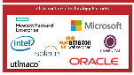
3. Initial Partners
R3 PORTFOLIO
1
Customers | Members | Stakeholders
2
CORDA PLATFORM
Regulators | Central Banks | Legal
3
Infrastructure Partners
Our initial partners were infrastructure-based companies like Microsoft, HPE, and Intel. These companies have been crucial to scaling our market delivery.
Notes:
R3’s strategy had always been underpinned by our core infrastructure partners. Microsoft, HPE, and Intel were crucial to our scaling and market delivery process. Microsoft had provided us with Azure credits for any level of blockchain environments with our members.

Slide 10
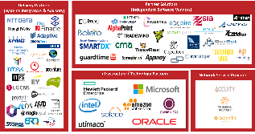
4. Partner Program
R3 PORTFOLIO
1
Customers | Members | Stakeholders
4
Partners
2
CORDA PLATFORM
Regulators | Central Banks | Legal
3
Infrastructure Partners
Expansion of the partner program included Delivery Partners (e.g. System Integrators and Dev Shops) and ISVs to execute and build top of stack applications (CorDapps).
R3’s Project Portfolio had organically evolved through multiple phases, but found System Integrators to be necessary for pilot/prod level commitment.
Notes:
As we continued to expand, the partner program became further segmented into delivery partners (like system integrators and dev shops) and solution partners (like market infrastructure players who would want to manage and deploy the applications). Our portfolio with the partner program had also evolved into larger longer-term commitments. Most members involved with innovation groups do not release to pilots or production, therefore the pressure to go-live made sense to work with larger commitments on a commercial focus. These partners augmented our corda development workforce and pitched for RFPs utilizing the corda platform for relevant use cases.

Slide 11
5. Corda Network
R3 PORTFOLIO
1
Customers | Members | Stakeholders
4
Partners
2
CORDA PLATFORM
Regulators | Central Banks | Legal
3
Infrastructure Partners
5
CORDA NETWORK
The Corda Network is the unifying ecosystem of Corda nodes in order to facilitate communication and deployment of CorDapps.
Corda nodes would be required for Members (on-prem/cloud installations), Partners (Business Networks), Third party service providers (oracles), and Corda Network Services (Notary, Doorman, Network Map).
Notes:
Corda Network is the unifying ecosystem of corda nodes in order to facilitate communication and deployment of CorDapps. The Corda nodes would include on-prem/cloud installations, third party service providers (like Thompson Reuters for market data services) and Business Networks (the software vendor managing the operational playbook for deployments and upgrades). More details on Corda Network will be provided in a subsequent section.

Slide 12
6. R3 Marketplace
R3 MARKETPLACE
6
R3 PORTFOLIO
1
Customers | Members | Stakeholders
4
Partners
2
CORDA PLATFORM
Regulators | Central Banks | Legal
3
Infrastructure Partners
5
CORDA NETWORK
Continual growth of CorDapps in the ecosystem are managed through the R3 Marketplace. This tool provides members and partners a place to match interests and initiate formal projects leading to CorDapp adoption.
Notes:
To round out the ecosystem, we are building an r3-based marketplace for better connecting solution consumers to service providers on corda. This product would allow for easier guided learning and discovery of available parties in the ecosystem.

Slide 13
R3’s Ecosystem
120+ Projects
Matchmaking Interests
R3 MARKETPLACE
6
R3 PORTFOLIO
1
Customers | Members | Stakeholders
4
Partners
Relationship Management
$ Consumers
Shared IP
Scaled Delivery
Certification
Extended Ecosystem
2
CORDA PLATFORM
Regulators | Central Banks | Legal
3
Infrastructure Partners
5
Enterprise-Grade
Privacy
Interoperability
Ease of Integration
CORDA NETWORK
Standing Ecosystem
Collaboration
Notes:
If we step back and look at the bigger picture:
we have the customers within the membership
an advanced enterprise-grade platform with corda
partners for scaled delivery and system integration
The corda connect ecosystem for standing collaboration
And the marketplace for active matchmaking and shared user experience within r3

Slide 14
Network effect across largest global ecosystem
Mutualize development, platform and network costs across 100+ member global ecosystem
Not a comprehensive list
Not a comprehensive list
Not a comprehensive list
Not a comprehensive list

Slide 15
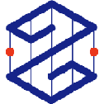


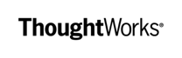







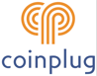
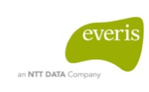

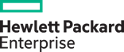
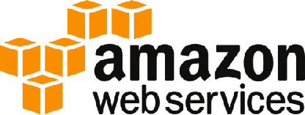


R3 Partners: Building the ecosystem to support Corda
Delivery Partners (S I & A*)
Partner Solutions (Independent Software Vendors)
Infrastructure / Technology Partners
Network Service Providers
*Systems Integrators and Advisory

Slide 16
Corda Vision
02
Notes:
This section aims to provide a high level overview of Corda’s vision

Slide 17


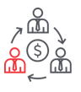

Enterprise-grade blockchain built from the ground up
LEDGERS
BLOCKCHAINS
Corda is an enterprise-grade blockchain platform that removes costly friction in business transactions by enabling institutions to transact directly using smart contracts while ensuring the highest levels of privacy and security.
INDUSTRY BLOCKCHAINS
INDUSTRY SHARED LEDGERS
CRYPTO-CURRENCIES
Privacy
Interoperability
Consensus
Notes:
There was no DLT technology that met the stringent requirements of the world’s largest financial institutions
This is why we built it: Corda
BLOCKCHAIN-INSPIRED: takes best attributes from Bitcoin, Ethereum, and others, such as smart contracts to allow a strong link between legal prose and smart contract code
SECURE: transactions information propagated only to relevant nodes to ensure data privacy
TRANSPARENT: Consensus achieved at individual deal level, rather than system level. Supports a variety of consensus mechanisms
EASY INTEGRATION: reuse existing developer skills and make integration with bank systems easy and safe, and with a performant B2B workflow. Contracts can be coded in modern, standard languages like Java
Corda is unique because it was built from the ground up from the demand of the consortium of financial institutions. The solution they sought must solve for the privacy and system integration requirements in the industry which were too broad when applied to the public blockchain space. These strict financial services non-functional requirements have since then applied to other non-financial use cases and industries.

Slide 18
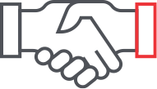

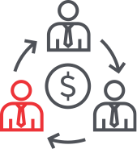
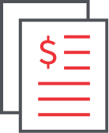
Corda: Blockchain for financial services and beyond
Privacy and Mutual Verification
“I know what I see is what you see”
Immutability
Smart Contracts
Notes:
Privacy and Mutual Verification
Facts are shared only with those directly transacting together, and verification consensus is achieved between them only
“I know what I see is what you see”
Records of shared facts and commercial agreements are consistent across entities, and enforceable through a legal framework
Immutability
All transactions and ledger records are chained together cryptographically to assure lineage and resistance to tampering
Smart Contracts
Ledger updates are controlled by business logic, encapsulated and executed in a deterministic, tamper evident manner
The properties of blockchain that we are inspired by were immutability, mutual verification, consistent ledger of shared facts, and smart contracts business logic.
Immutability in corda’s case is tamper-evident transactions between multiple parties – this is a history chain of provenance for shared facts.
The shared facts must reach consensus through a series of agreed upon governance mechanisms.
The consistency of shared facts can be the specific metadata of the legal agreement or the attachment of the legal agreement itself through multiple events of a legal agreement’s life cycle.
Smart contracts provide a published piece of software that executes agreed upon business logic in a deterministic and tamper-evident way

Slide 19



Industry problem: what I see is NOT what you see
This is what I think I am owed
This is what I think I owe
We both see the same thing
We both see the same thing
Supplier
TODAY
Customer
Supplier
TOMORROW
Customer
Do work
Pay Bill
Do work
Pay Bill
Record Work
?
Acknowledge work
Shared Truth
Record Work
Acknowledge work
Apply Credit
Confirm credit
Shared business logic
Apply Credit
Confirm credit
Generate invoice
Key in accounts payable
Shared data
Generate invoice
Key in accounts payable
Post Invoice
Receive Invoice
Shared network
Post Invoice
Receive Invoice
Notes:
When we stepped back and looked at where different members were reviewing blockchain technologies, we found that they were trying to solve for guaranteed information transport and infrastructure savings within a permissioned set of trusted parties. The key problem was “What I see is not what you see” because the siloed processing of data is done independently by each system and with many manual intervention points when comparing the recorded work across both systems. What this technology ultimately promises is not just a shared network and shared data for golden source, but also shared business logic and a shared view of truth for multiple parties.

Slide 20
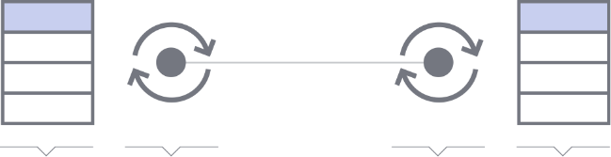
Privacy
Financial-grade privacy
Corda is a point-to-point system - a fundamental architectural difference to other systems
Only Corda enables privacy with transactions only shared with parties relevant to the transaction
This ensures transaction tear-offs and confidential identities
Ledger
Smart
contract
Smart
contract
Ledger
Notes:
Rather than a gossip network, Corda utilizes a point-to-point system via MQ messages. This means that corda does not have full database replication, but it does provide a chain of replicated data between knowing parties. If these shared facts were a bilateral agreement between participants then only those participants would receive a copy of the document. In the blockchain world, the document or hash of the document would be sent to all parties to prove this document’s existence.

Slide 21
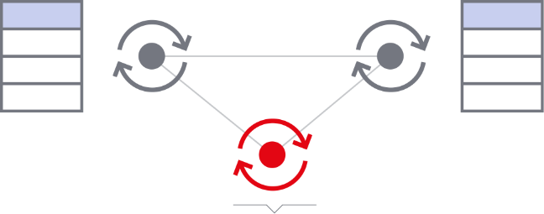
Consensus as a service
Consensus at an individual level
Only Corda separates the trust mechanism from the node allowing a pluggable consensus service which we call a notary
Consensus algorithms can be chosen at the transaction level, not the blockchain level
Consensus service (Notary)
Notes:
Most public blockchains like Bitcoin and Ethereum use proof of work block-based consensus. This is the process of collecting transactions from multiple parties and using a lottery-based validation for deciding the new block. Corda uses real-time consensus for transactions. The consensus mechanism is also pluggable and exchangeable based on the different requirements of each transaction. For example, a cash state could choose a non-validating consensus in a specific notary while an asset state could use a validating consensus in a separately owned notary pool.

Slide 22
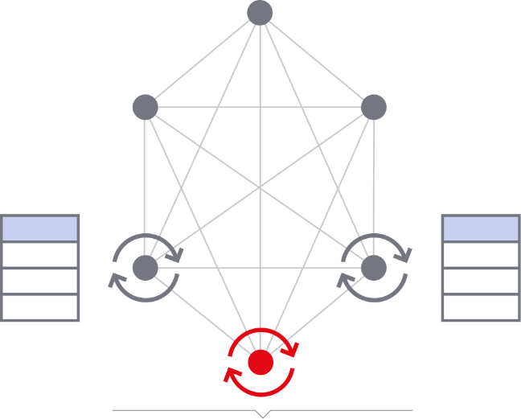
Compatibility
Record, manage and synchronize
Trust, and therefore compatibility, is rooted at the identity level
Corda allows any node to transact with any other node so long as they are in the same interoperability zone
Alternate solutions can only achieve this in the absence of privacy
Interoperability Zone
Notes:
Corda nodes can also run multiple cordapps. A corda node with a known identity can interact with other nodes running the same applications. This is managed by a business network.

Slide 23
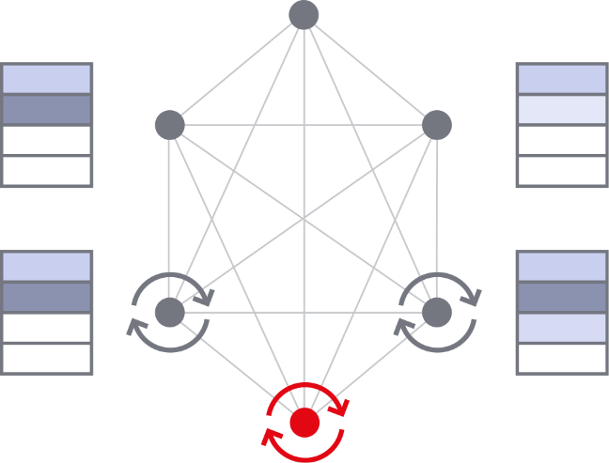
Business Networks
Technology to power a global network
Only Corda can enable a global network of interoperable nodes while still supporting private business networks
One node can participate in many networks. The networks can set policies and enforce membership creating permissioned networks inside an interoperable network
Notes:
The business networks manage, operate, and upgrade the membership of corda nodes running their cordapp. This governance provides different software partners with tools to manage and synchronize installations across multiple organizations

Slide 24
Oracles
A complex network to enable data services
Oracles provide information into transactions in an immutable, deterministic manner. The network of interoperable nodes can leverage a rich network of data providers
Notes:
Bilateral agreements may require specific inputs of agreed upon data sources. These third party data providers are named oracles. Oracles can serve as market data inputs or shared libraries of calculations between parties.

Slide 25
Corda design trade-offs
TRADITIONAL BLOCKCHAINS | CORDA
Block-based Consensus Difficulty with Performance / Scaling Validator governance | Real-time Flow-based Consensus Allows for Parallel/Multi-threading without Sharding Latency associated with # of participants per state
Gossip / Broadcast Network | Point-to-Point messaging with Observer Nodes
Full Replication on Databases Difficulty on Privacy & Data storage | Partial Replication on States Relies on traditional database back-up
Anonymous Wallets Feature, but must be governed in a permissioned network Allows for more B2C (but in an unregulated way) | Single Node Identity (1-to-1 Mapping) Must have a node to participate → Leads to more B2B use cases
UTXO (for coins) / Replicated VM (for Ethereum) | UTXO
Notes:
In summary, corda was inspired by the blockchain architecture, but made specific architectural decisions that help the technology adhere to the requirements within regulated financial institutions and other regulated industries.
Real time consensus allows for parallel processing without complex sharding.
Point-to-point messaging ensures only the permissioned data is sent between parties
Replication only occurs on the data level rather than the database (which also means corda relies on traditional database backups for recovery/high availability)
Nodes are provided with a single identity to remove the anonymous wallets feature behind the public space. This trade-off also means our use cases currently focus on business-to-business interactions in the wholesale rather than retail space

Slide 26


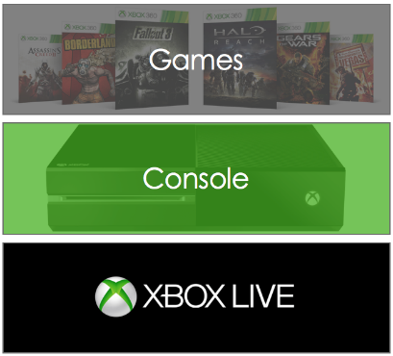
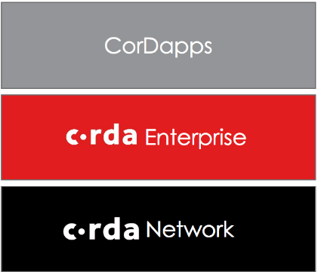


The Corda stack
Users
Banks and Customers
Your CorDapp(s)
Customers
Your CorDapp(s)
enterprise
network
Notes:
Since Microsoft is a long time partner, we like to use the XBOX analogy for describing r3’s platform approach. Similar to XBOX, the console is an on-premises installation with the capability of playing different games and connecting to other players playing that game via XBOX Live. The games themselves are not all written by Microsoft, but the ecosystem allows for a competing number of games that cover similar genres.
Within Corda, we imagine r3 corda to be a platform owned by our members that allow them to install CorDapps that would communicate with each other via corda connect. The CorDapps themselves are being pursued by different partners or joint ventures of members building to solve for a use case. R3 is not building top of stack applications, but enabling the marketplace to apply the corda technology to their existing applications.

Slide 27
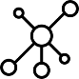


Corda current ecosystem
INCENTIVES:
CorDapp Users
Make Business Line Money
Consumer
FIs
Insurance
Regulators
Projects / RFPs
Corda Execution Partners
Builder
Feature Complete
Sell Headcount and Projects
Integration Layer
Integrator
Testing
CorDapp “Hosters”
Business Network Operator
Coordinate Deploy
Service SLAs
Sell CorDapp Licenses
Upgrades
Cloud Hosting
Security Hardware
Sell Per Transaction
Corda Infrastructure
Business Network Support
Notary
Doorman
Network Map
Oracles
Notes:
The larger ecosystem from top to bottom shows the interaction of different parties to create and maintain a CorDapp within Corda Network
The consumers often provide the requirements and narrow down the use cases for projects/RFPs representation
The project process allows delivery partners to better understand the nuances and requirements
The solutions are production-level systems run by a Business Network. The business network in a decentralized/distributed system is either a large market infrastructure company of a consortium that creates the proper governance
In terms of the supporting infrastructure, each business network will share node identity, network map, notary, and other third party services like oracle market data providers
More broadly, the incentives to build on this ecosystem covers the core customers being supported. Innovation leads want a product that can make their business money and also adhere to new regulatory standards or decommission legacy systems. Delivery partners are participating to sell headcount on projects and connect with more members around the world. Business Networks are selling licenses and deploying to our large member network. Corda Network services from the infrastructure side are likely going to sell by compute power or per transaction.

Slide 28

Bringing real world business solutions to our clients
CorDapps are developed by our partners and run across a common layer of identity, consensus and governance, making them fully interoperable
Securities services
Insurance
Cash and payments
Trade finance
Capital markets
Issue
Trade
Hold
Efficiency
Cost saving
Risk reduction
Digital cash
CBDC and non-CBDC
Domestic and International payments
Optimizing the supply chain
Full trade lifecycle
Portfolio construction
Deal and order management
Regulatory reporting
CorDapps
PARTNERS

Slide 29
Corda Concepts
03
Notes:
This section aims to review corda building blocks and fundamentals. More details on this are available directly in lessonly courses or in the docs.corda.net key concepts videos.

Slide 30
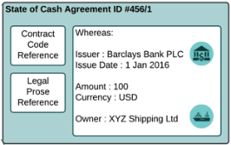
Corda key concepts
4
Transactions enable transition between states
1
Transactions (defined)
State Object creates properties / fields for the given financial agreement
2
Transfer (whole)
Contract Code:
Verify that:
Transfer (whole):
Rule 1 { code }
Transfer (partial):
Rule 1 { code }
Rule 2 { code }
Transfer (partial)
Redeem
No output State
5
Consensus is reached on transaction validity and uniqueness
3
Legal Prose:
The Ricardian Contract is composed of legal prose, parameters and contract code
6
Flows defined for specific data sent to each node/identity (e.g. FI vs regulator vs uniqueness service)

Slide 31
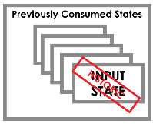
Corda: building blocks
State Object
States are immutable objects that represent (shared) facts such as a financial agreement or contract at a specific point in time
Transaction
Transactions consume input states and create output states.
The newly created output states replace the input states which are marked as historic.
Consensus
Parties reach consensus on the evolution of a shared fact. This is done by testing the validity (by way of contract code) and uniqueness (by way of the notary) of the transaction.
Proof of work in Bitcoin is generalization to Consensus mechanisms applied on Corda.
Flows
Flows are light-weight processes used to coordinate interactions required for peers to reach consensus about shared facts.
Notes:
Corda’s architecture is built on States, Transactions, and Flows.
States can be thought of as the terms inside of a legal agreement. It can only be changed using transactions, which creates a chain of provenance on all changes.
Transactions consume input states and create output states. This is used the same way as in Bitcoin with structured changes to the database.
Flows are real-time processes used for reaching consensus on a single transaction between the parties in a point-to-point messaging manner

Slide 32
State object
Corda controls the evolution of agreements, which are represented by states.
State of Cash Agreement
Contract Code Reference
Contract Code
Legal Prose
Details
Legal Prose Reference
Notes:
Corda is essentially a state machine that manages the controlled evolution of agreements. If you look at bitcoin, the “state” represented only stores data about the date, amount, and owner’s public address. The bitcoin smart contract checks that the private key matches with the current owner and the transaction evolves the state to change the owner to another party. In this case, Exporter Ltd signed the contract to change the owner to Exporter Bank Ltd. This smart contract code is part of the cash agreement defined by the contract code in corda.

Slide 33
Contracts
Corda mandates that each state inside a transaction must reference a contract
TRANSACTION STATE
CONTRACT
IOU STATE PROPERTIES
IOU CONTRACT CODE
REFERENCES
IOU CONTRACT REF
PARTICIPANTS
Alice
Bob
IOU LEGAL PROSE
Notes:
Corda states must reference corda contracts (which include contract code and legal prose). The state properties can only evolve based on the definitions set by the contract code verify() functions

Slide 34
Contract Code
CASH CONTRACT
As transactions may contain multiple state types, multiple contracts can be referenced in a transaction
The Corda platform will use all referenced contract code to verify a (proposed) transaction
REFERENCES
REFERENCES
VALIDATES
CASH₀
CASH₁
BOND₁
BOND₂
REFERENCES
VALIDATES
REFERENCES
BOND
CONTRACT
Notes:
Corda contract code validates the evolution of specific states. A transaction can include multiple state evolutions referencing their respective contracts. The corda platform will use all contract code to verify the transaction.

Slide 35


Simple to Complex Transactions
INPUT CASH
Pay/Transfer
OUTPUT CASH
NO INPUT
Issue
OUTPUT CASH
INPUT ASSET
Trade/Transfer
OUTPUT ASSET
INPUT CASH
Pay/Transfer
OUTPUT CASH
Issue: Enter into ecosystem
Pay/Transfer: Simple change of ownership
DVP: Combined/Nested Transactions
Exit: Exit out of ecosystem
INPUT CASH
Exit
NO OUTPUT
Notes:
The most basic transactions include Issue, Transfer, and Exit for cash states. Issuance in Bitcoin would be the creation of bitcoin to specific miners that have won the block. Similarly in corda, the issue cordapp will likely be permissioned to a subset of corda nodes (like central bank nodes). Corda also allows for more complex transactions like Delivery Versus Payment. The right example shows the consumption of the input cash owned by the green bank changing to an output cash owned by blue bank. Within the same transaction, the input asset owned by blue bank is changed to an output asset owned by green bank. States do not exclusively have to be ownable aspects like cash or assets, but can represent any other intermediate account states like trades for changing statuses.

Slide 36
Flows Framework
7. The notary cluster orders and finalizes the transaction
6. Alice sends the signed transaction to the notary cluster
NOTARY CLUSTER
1. Alice creates a new transaction proposal and signs it
5. Alice verifies the transaction and checks Bob’s signature
ALICE
4. Bob sends back the transaction and his signature to Alice
2. Alice sends the proposal and her signature to Bob
3. Bob inspects the proposal, verifies it and then signs it
BOB
Uninvolved peers do not receive any of Alice’s or Bob’s transactions
Notes:
Now that we understand transactions, the verification and validation of these transactions occurs through a real-time negotiation framework called flows. This is written code that allows for the passing around of a partial transaction to gather signatures. Here, Alice creates a new transaction → sends it to Bob to inspect the proposal and verify and sign it → transaction gets sent back to alice to verify and sign. Then the transaction is sent to the notary cluster for a final signature, then all parties receive the transactions in order to commit the final changes. Note that the two peers on the edge of the network do not receive any of Alice or Bob’s transactions.

Slide 37
Corda Architecture
04
Notes:
This section aims to introduce the corda architecture from a fundamental network, node, and applications level.

Slide 38





Traditional vs Corda architecture
A’s View
B’s View
A’s View
B’s View
WEB
WEB
Biz Logic
Biz Logic
Biz Logic
Biz Logic
MIDDLEWARE
MIDDLEWARE
DATABASE
Data Data
Data Data
DATABASE
Manual Reconciliation processes
Common Messaging Engine
and Workflow Management
CONSENSUS PROTOCOL
CSV
SFTP
JSON
/ XML
Notary Cluster
Network Map
CONSENSUS SERVICES
Doorman
Notes:
Visually, the left side shows the traditional 3-tier web-middleware-database combination with manual reconciliation processes comparing and feeding data via CSV and SFTP reconciliation. The right side shows corda’s red boxes which indicates the shared software versions and business logic. Having a common set of protocols and distribution mechanisms for middleware/web allow for corda to maintain an efficient transport data layer between organizations and across industries.

Slide 39


Corda architecture impact
NODE EXPLORER
Pluggable web
A’s View
B’s View
C’s View
WEB
Unified Biz Logic via smart contracts
Running same CorDapp
MIDDLEWARE
Biz Logic
Biz Logic
Biz Logic
Data
Data
Data
On-premises private unique databases
Pluggable database
DATABASE
CONSENSUS
PROTOCOL
Common Messaging Engine and Workflow Management
INFRASTRUCTURE
SERVICES
Notary Cluster
Network Map
Doorman
Permissioned Network
Prevent Double Spend
Notes:
In corda, we still require a sharing of software, but we’ve split the layers into the corda distributed application (CorDapp), corda core, and infrastructure business network services.
The top block of applications focuses on writing unified business logic via smart contracts. These are common APIs and can include reusable frontend views. Since corda focuses on being a middleware platform, we understand most financial services applications will want to reuse their own application frontends and only use corda for coordinating movement/settlement of states.
Note that the database does not show a replicated databases across all instances. Instead, it shows a link between specific pieces of data. This is because corda databases are individually unique and only store a subset of data linked together. These databases are meant to be owned and controlled by the institutions and can be pluggable with different SQL-based JDBC compliant databases
The consensus protocol layer is the core corda .jar platform. This ensures the corda nodes running these cordapps all use the same MQ messaging, transactions, flow framework for gathering signatures, and serialization for message movement
The infrastructure services in the bottom layer include the notary pools (which is required to prevent double spend within the corda network) and the network map and doorman (which act as the identity issuance for all corda nodes in the permissioned network).

Slide 40
Corda architecture impact
NODE EXPLORER
Pluggable web
WEB
App
App
App
App
App
App
Unified Biz Logic via smart contracts
Running same CorDapp
MIDDLEWARE
Vault
Vault
Vault
Pluggable database
On-premises private unique databases
DATABASE
CONSENSUS
PROTOCOL
Common Messaging Engine and Workflow Management
INFRASTRUCTURE
SERVICES
Notary Cluster
Network Map
Doorman
Permissioned Network
Prevent Double Spend
Notes:
Another view of this architecture is showing the stack as single corda nodes with multiple installed CorDapp diamonds and a single Vault for secured data. These three different Corda nodes are owned by different legal entities. This diagram will be referenced in different capacities throughout the high level explanations of the nodes.

Slide 41
Logical architecture
WITHIN CORDA NETWORK
OUTSIDE OF CORDA NETWORK
AMQP
Notary
Bank A
Bank X
Doorman Service
CLIENT
NODE
CLIENT
NODE
GUI
…
NODE
REST API
Web Server
DATABASE
AMQP
AMQP
DATABASE
NODE (JVM)
RPC
Client
DATABASE
Network Map Service
CordaRPCOps
CorDapp
NODE
AMQP
APIs
STATES
CONTRACTS
Central Bank
CLIENT
FLOW
AMQP
NODE
DATABASE
ServiceHub
Vault
Tx Storage
AMQP
Oracle
NODE
DATABASE
JDBC
DATABASE
AMQP
Linux VM on Azure
DATABASE
AMQP
Notes:
On a node level, each bank’s corda node includes the client, JVM, and database layers, which communicate to other nodes in the network via AMQP. The client of the node mainly uses RPC client to call the APIs exposed by the written CorDapp. The Servicehub uses JDBC for any connections to the database.

Slide 42
Corda Enterprise
05
Notes:
In this section, we aim to provide an overview of when corda should be considered

Slide 43
Corda Enterprise is a commercial distribution of Corda software specifically optimized to meet the demands of modern day business.
Notes:
However, many institutions, especially larger ones with complicated IT states and networks face technical headwinds that prevent the adoption of an open source blockchain platform.
While the base platform remains open, Corda Enterprise harnesses the most appropriate elements from the core offering and fine-tunes them for the enterprise market.

Slide 44
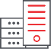





Corda Enterprise mission-critical features
Blockchain Application Firewall
Enables Corda Enterprise to be deployed inside corporate datacenters while retaining the ability to communicate securely with other nodes anywhere else in the world
24/7 support and predictable release schedules
Support includes governance, performance and availability monitoring, enhanced security, high-availability, disaster-recovery and high-performance modes, ensuring no system failures
.
Oracle and SQL server databases
Supports facilitating seamless integration with industry-standard enterprise databases
Compatibility
Cross-distribution and cross-version wire compatibility, together with the ability to operate mixed-version networks and a Corda node inside a corporate firewall.
Corda Network
Access to the world's first universally interoperable blockchain network, supporting multiple CorDapps on the same network, enabled by Corda's privacy model.
Notes:
Corda Enterprise is designed for organizations with specific requirements around quality of service and the network infrastructure in which they operate.
For example, an organization may want to run their node really close to applications they’re wanting to bring into synch, yet the node has to be able to access other nodes across network. So, we invented the Blockchain Application Firewall, which enables customers to run Corda Enterprise node deep inside data center while retaining the ability to communicate securely with other nodes anywhere else in the world.
Most banks require that all data be stored in industry-standard enterprise database, such as SQL server and Oracle. We will support them, facilitate integration and remain certified to do so.
Customers need to know that if the underlying hardware running on fails, the node will be brought back to life. We offer that with high availability and disaster-recovery, ensuring no system failures.
We’ve added 24/7 support and predictable release schedules; product management support so you can request additional features.
Corda Enterprise also includes Corda Network, which enables multiple applications to interoperate

Slide 45
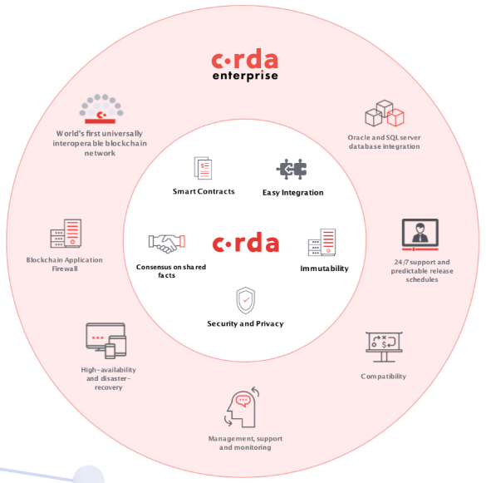

Corda and Corda Enterprise: seamless interoperability
Notes:
Interoperability is a key aspect of Corda’s design. Its applications and services run across a common layer of identity, consensus and governance, which we call Corda Network. This means businesses can transact openly and flawlessly with all their business partners, without trapped assets or islands of information.
Corda and Corda Enterprise are fully interoperable, meaning companies using either can trade with each other, and that one organization can run both platforms seamlessly across different divisions.
It really is the best of both worlds.

Slide 46


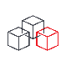
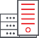

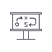


Blockchain for every business in every industry
Select a version of Corda that fits your unique needs – regardless of industry, size, budget, and stage of development
CorDapps
PARTNERS
Corda (open source)
Corda Enterprise
Freely available as open source code. Download the platform and start developing on it today.
Commercial distribution of Corda software with additional mission-critical capabilities specifically optimized to meet the demands of modern day businesses.
Notes:
With the launch of Corda Enterprise, companies can now select a version of Corda that fits their unique needs – regardless of their industry, size, budget and stage of development.
This means a wider range of institutions can realize the full potential of blockchain – executing complex logic and exchange of assets directly, simply and in strict privacy, without the need for costly reconciliation or a trusted intermediary.

Slide 47
Ready for Production
SECTION
06

Slide 48
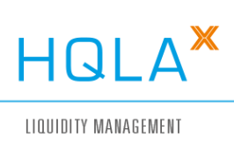





Project HQLAx Tokenization of baskets of securities to distribute liquidity more efficiently
Network of Participants
A collateral lending solution for sourcing or providing High Quality Liquid Assets (HQLA)
Notes:
VISION
A collateral lending solution for sourcing or providing High Quality Liquid Assets (HQLA) on R3’s Corda
OBJECTIVES
To build an exchange that improves HQLA upgrade / downgrades by utilizing distributed ledger technology for the tokenization of baskets of securities that allows for quick, legal transfer of HQLA and re-hypothecation
BENEFITS
Improve collateral fluidity with an operating model that does not require securities to be moved across CSDs
Real-time and atomic legal title transfer enabling DvD (Delivery vs. Delivery) of baskets of securities
Enhance regulatory transparency of collateral chains via a standardized and transparent marketplace, with a “Collateral Tracking” view for regulators
Mitigate systemic risk by enabling orderly default unwinds
(March/2018) HQLAX, together with Credit Suisse and ING, have completed the first live securities lending transaction settled using R3’s Corda blockchain platform.
In the ground breaking transaction, Credit Suisse and ING swapped baskets of securities of value EUR 25 million using the HQLAx Corda-based collateral lending application. This new milestone brings the HQLA^{X} collateral lending CorDapp, one step closer to production.

Slide 49


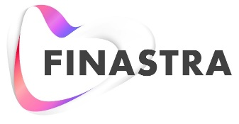

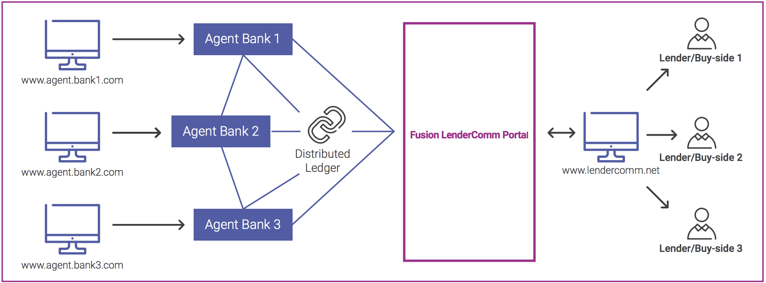


Project LenderComm Automation of lender communications between agent banks and lenders
Network of Participants
A platform for the syndicated lending that exposes real-time credit agreement, accrual balances, position information and detailed transaction data to lenders.
Notes:
VISION
To build a distributed ledger technology platform for the syndicated lending community
OBJECTIVES
To drive transparency and efficiency in the syndicated loan market
BENEFITS
By using Corda, Project LenderComm exposes real-time credit agreement, accrual balances, position information and detailed transaction data to lenders, directly from agent bank loan servicing platforms such as Finastra’s Fusion Banking Loan IQ. Project LenderComm aims to slash operational cost and slash operational cost and burden of agent to lender administration and deliver self-service capabilities to lenders, providing accurate information on demand to optimize loan portfolios

Slide 50



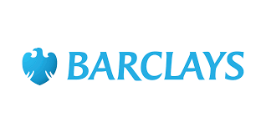


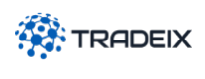
Project Marco Polo Tracking goods and trade documents
Network of Participants
Phase 1
An open, shared platform that makes trade safer, simpler, and more inclusive, connecting the ecosystem of banks, buyers, suppliers, technology providers, insurers, and others.
Technology Provider
Notes:
VISION
To develop an end-to-end open account trade platform. The platform consists of trade finance solutions, APIs and developer tools on an open technology infrastructure powered by Corda DLT
OBJECTIVES
To provide an open, shared platform that makes trade safer, simpler, and more inclusive, connecting the ecosystem of banks, buyers, suppliers, technology providers, insurers, and others critical to facilitating global open-account trade flows
BENEFITS
Enable trading parties and their financiers to dramatically cut back-office costs
Eliminate operational friction
Reduce fraud and compliance risk
Open up new revenue streams
Enable entirely new ways of managing and financing trade.

Slide 51
“R3’s Corda dominates insurance sector”
Notes:
There was no DLT technology that met the stringent requirements of the world’s largest financial institutions
This is why we built it: Corda
BLOCKCHAIN-INSPIRED: takes best attributes from Bitcoin, Ethereum, and others, such as smart contracts to allow a strong link between legal prose and smart contract code
SECURE: transactions information propagated only to relevant nodes to ensure data privacy
TRANSPARENT: Consensus achieved at individual deal level, rather than system level. Supports a variety of consensus mechanisms
EASY INTEGRATION: reuse existing developer skills and make integration with bank systems easy and safe, and with a performant B2B workflow. Contracts can be coded in modern, standard languages like Java

Slide 52
Summary
SECTION
07

Slide 53
Translating to Corda design
Parties (nodes & identities)
who’s running nodes and who needs to see the data?
States (data models)
what is the specific data that is shared between parties
Contracts (verify())
how will that data evolve over time?
Transactions (evolution of data)
all transactions will cover the full scenarios and use cases for evolving one or more states
Flows (Consensus)
within the transactions, who will need to sign and save the data?
docs.corda.net
Notes:
To summarize the questions, think about these CorDapp design properties that will need to be captured from business requirements. The 5 main areas to ask questions about include:
Parties – who’s running nodes and who needs to see the data?
States – what is the specific data that is shared between parties
Contracts – how will that data evolve over time?
Transactions – at a high level all transactions will cover the full scenarios and use cases for evolving one or more states
Flows – within the transactions, who will need to sign and save the data?

Slide 54
Sample CorDapps – www.corda.net/samples
Corda Open Sourced Samples | Purpose / Proof
Obligation CorDapp | Shows the creation of multiple currencies, IOUs, and payment of IOUs between parties https://github.com/roger3cev/obligation-cordapp
Crowdfunding | Uses Observers feature from v2.0 https://github.com/roger3cev/observable-states
Oracle-Example | Shows the pattern of reading from an oracle https://github.com/roger3cev/oracle-example
FTP CorDapp | Sends files between corda nodes https://github.com/ragmondo/cordaftp
Anonymous public keys | Confidential identities using anonymous public keys https://github.com/joeldudleyr3/whistleblower
Heartbeat | Scheduled states to cause your node to emit a heartbeat every second https://github.com/joeldudleyr3/heartbeat
Flow HTTP | Make http requests https://github.com/joeldudleyr3/flow-http
Node Info | Gradle project and task to retrieve node information https://github.com/ragmondo/corda-nodeinfo
Notes:
Since the open source of corda and additional features, the developer relations team has written a lot of samples for the developer training class and extensions to different cordapp functions. The two we use frequently are the Obligation CorDapp and Crowdfunding CorDapp. The obligation cordapp shows the fulfillment of corda states on IOUs between parties. The crowdfunding cordapp shows the observer node functionality that sends corda states to multiple parties without requiring individual signatures. All of these samples are available on www.corda.net/samples

